Slide 1
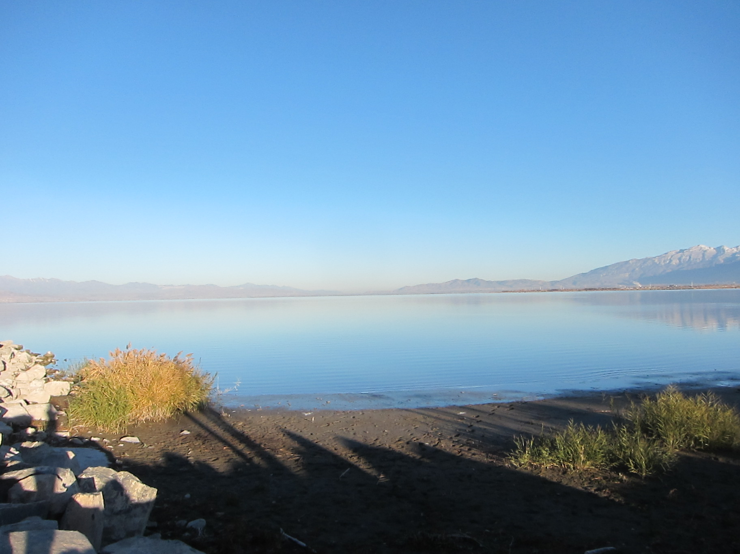
Assessment of Anthropogenic Impacts on the Utah Lake Ecosystem
-Integrating a Multi-Proxy Approach and GIS Spatial Analysis Technique
Dr. Weihong Wang
Utah Valley University
3/30/2017
Utah Lake Education Presentation

Slide 2
Outline
Utah Lake and Jordan River Transect Study
Temporal and Spatial Variation of Trace Metal Loading to Utah Lake Study
Orem Waste Water Treatment Plant Trace Metal and Nutrient Loading to Utah Lake Study
Integration of Geochemical Data and GIS Analysis Study

Slide 3
Study Sites

Slide 4
Study Sites

Slide 5
Study Sites

Slide 6
Objectives
Examine changes in C and N isotopic composition, and C: N ratio against pre- and post-settlement history
Investigate changes in trace metal concentrations from pre- and post-settlement history
Assess temporal and spatial variations of trace metal and nutrient loading to Utah Lake
Quantify trace metal and nutrient loading to Utah Lake from point pollution sources
Integrate geochemical data with GIS spatial analysis to model the trace metal concentration variations in Utah Lake

Slide 7
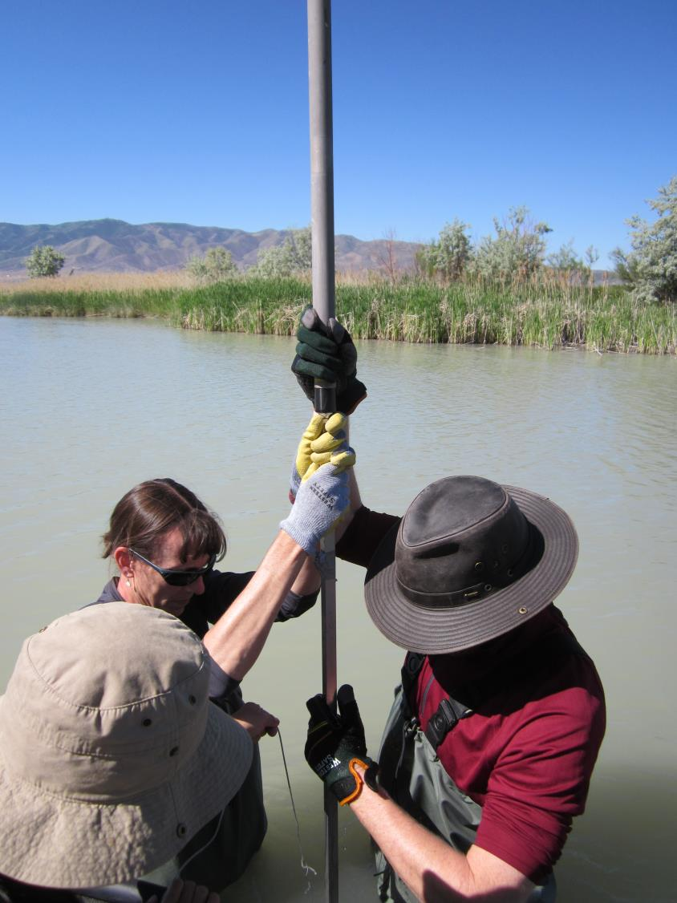
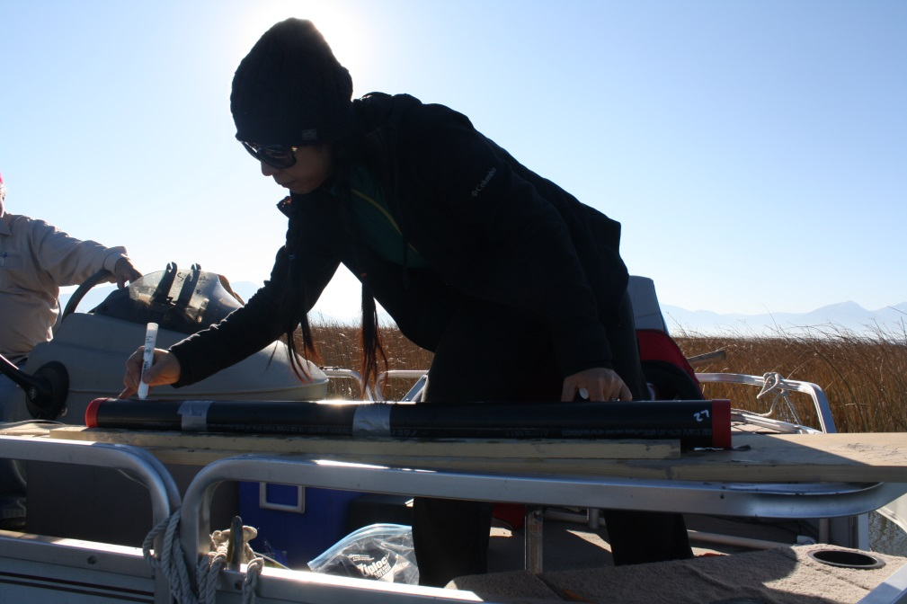
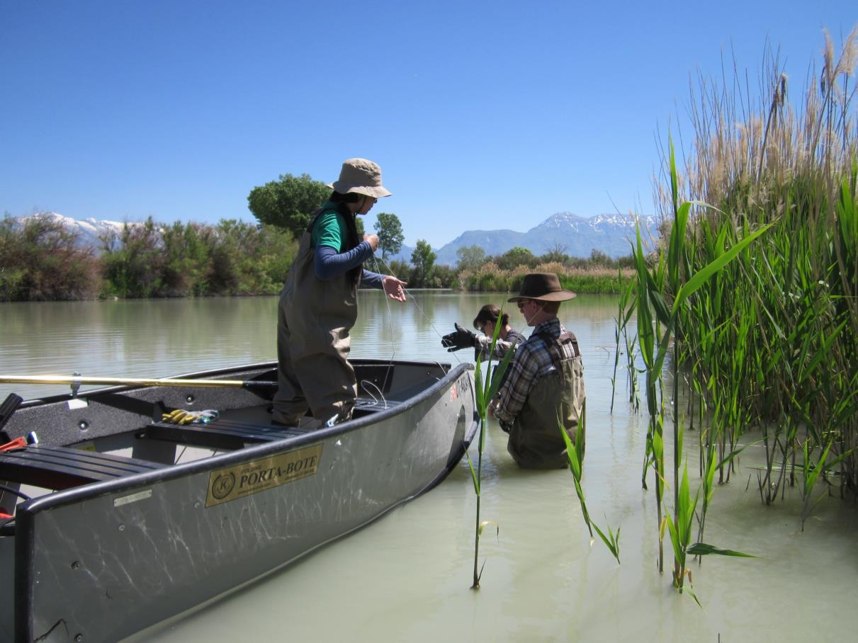


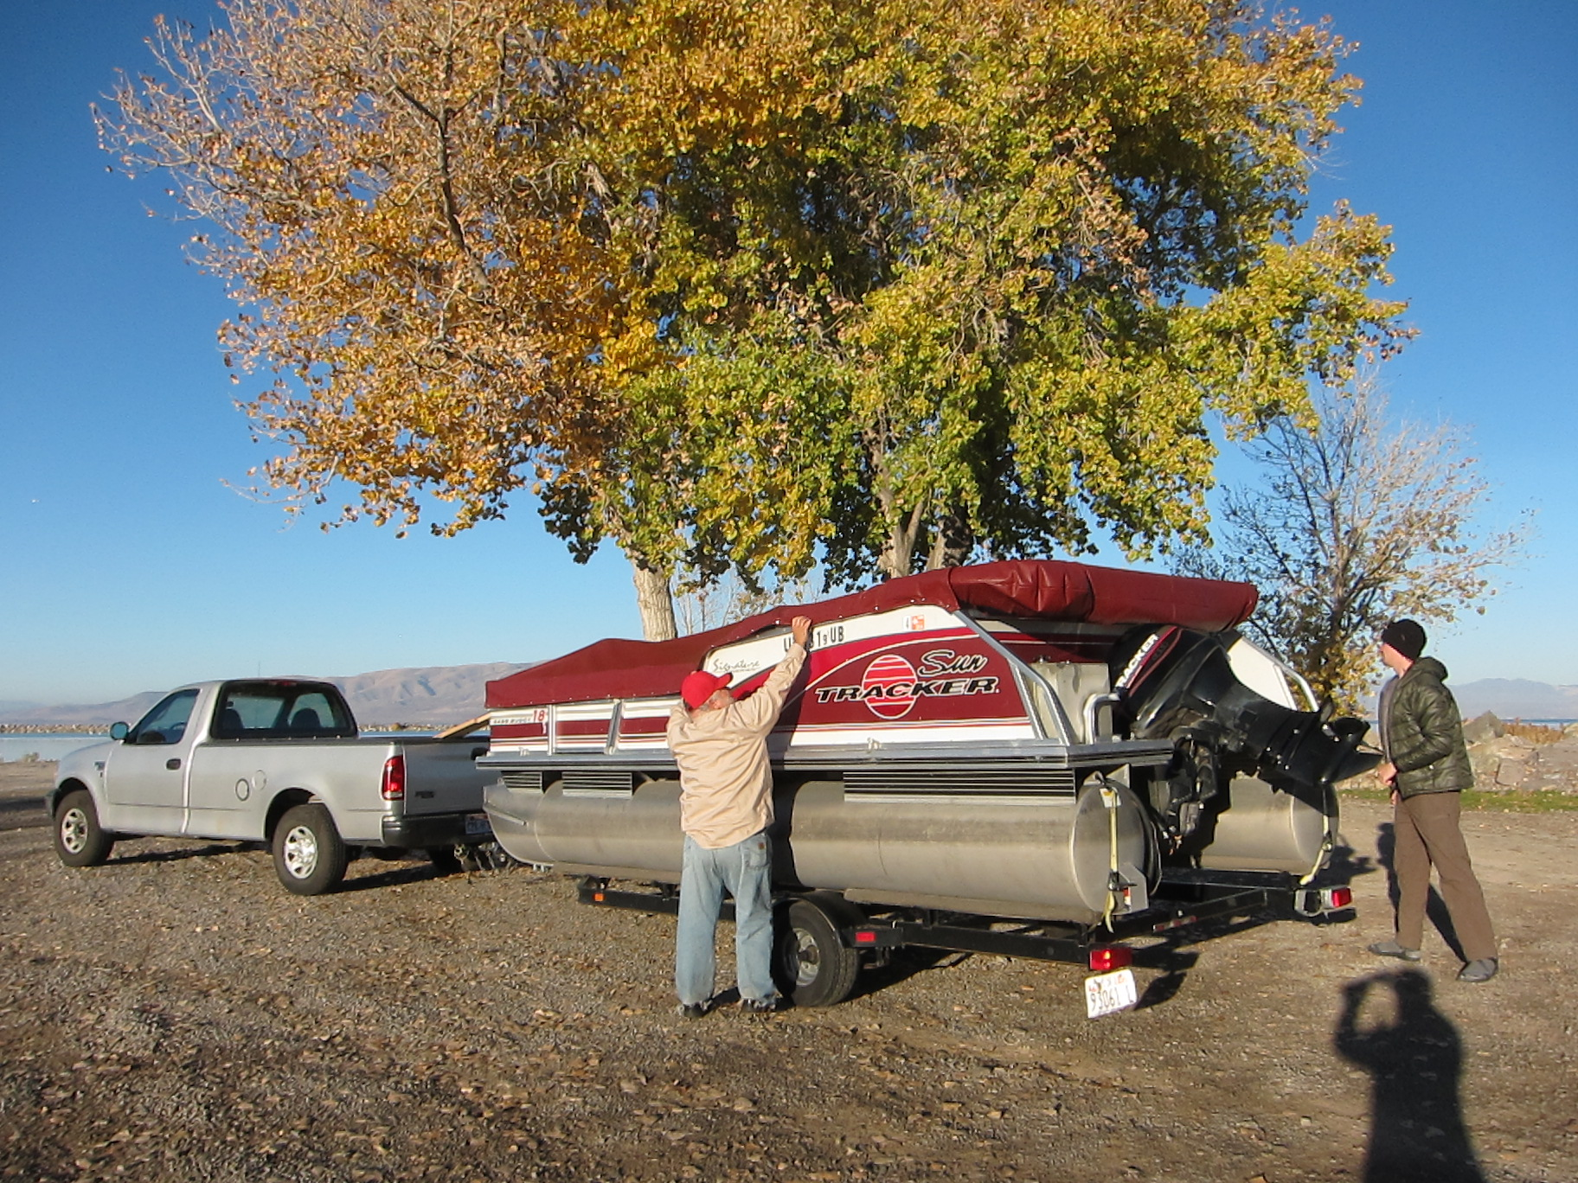
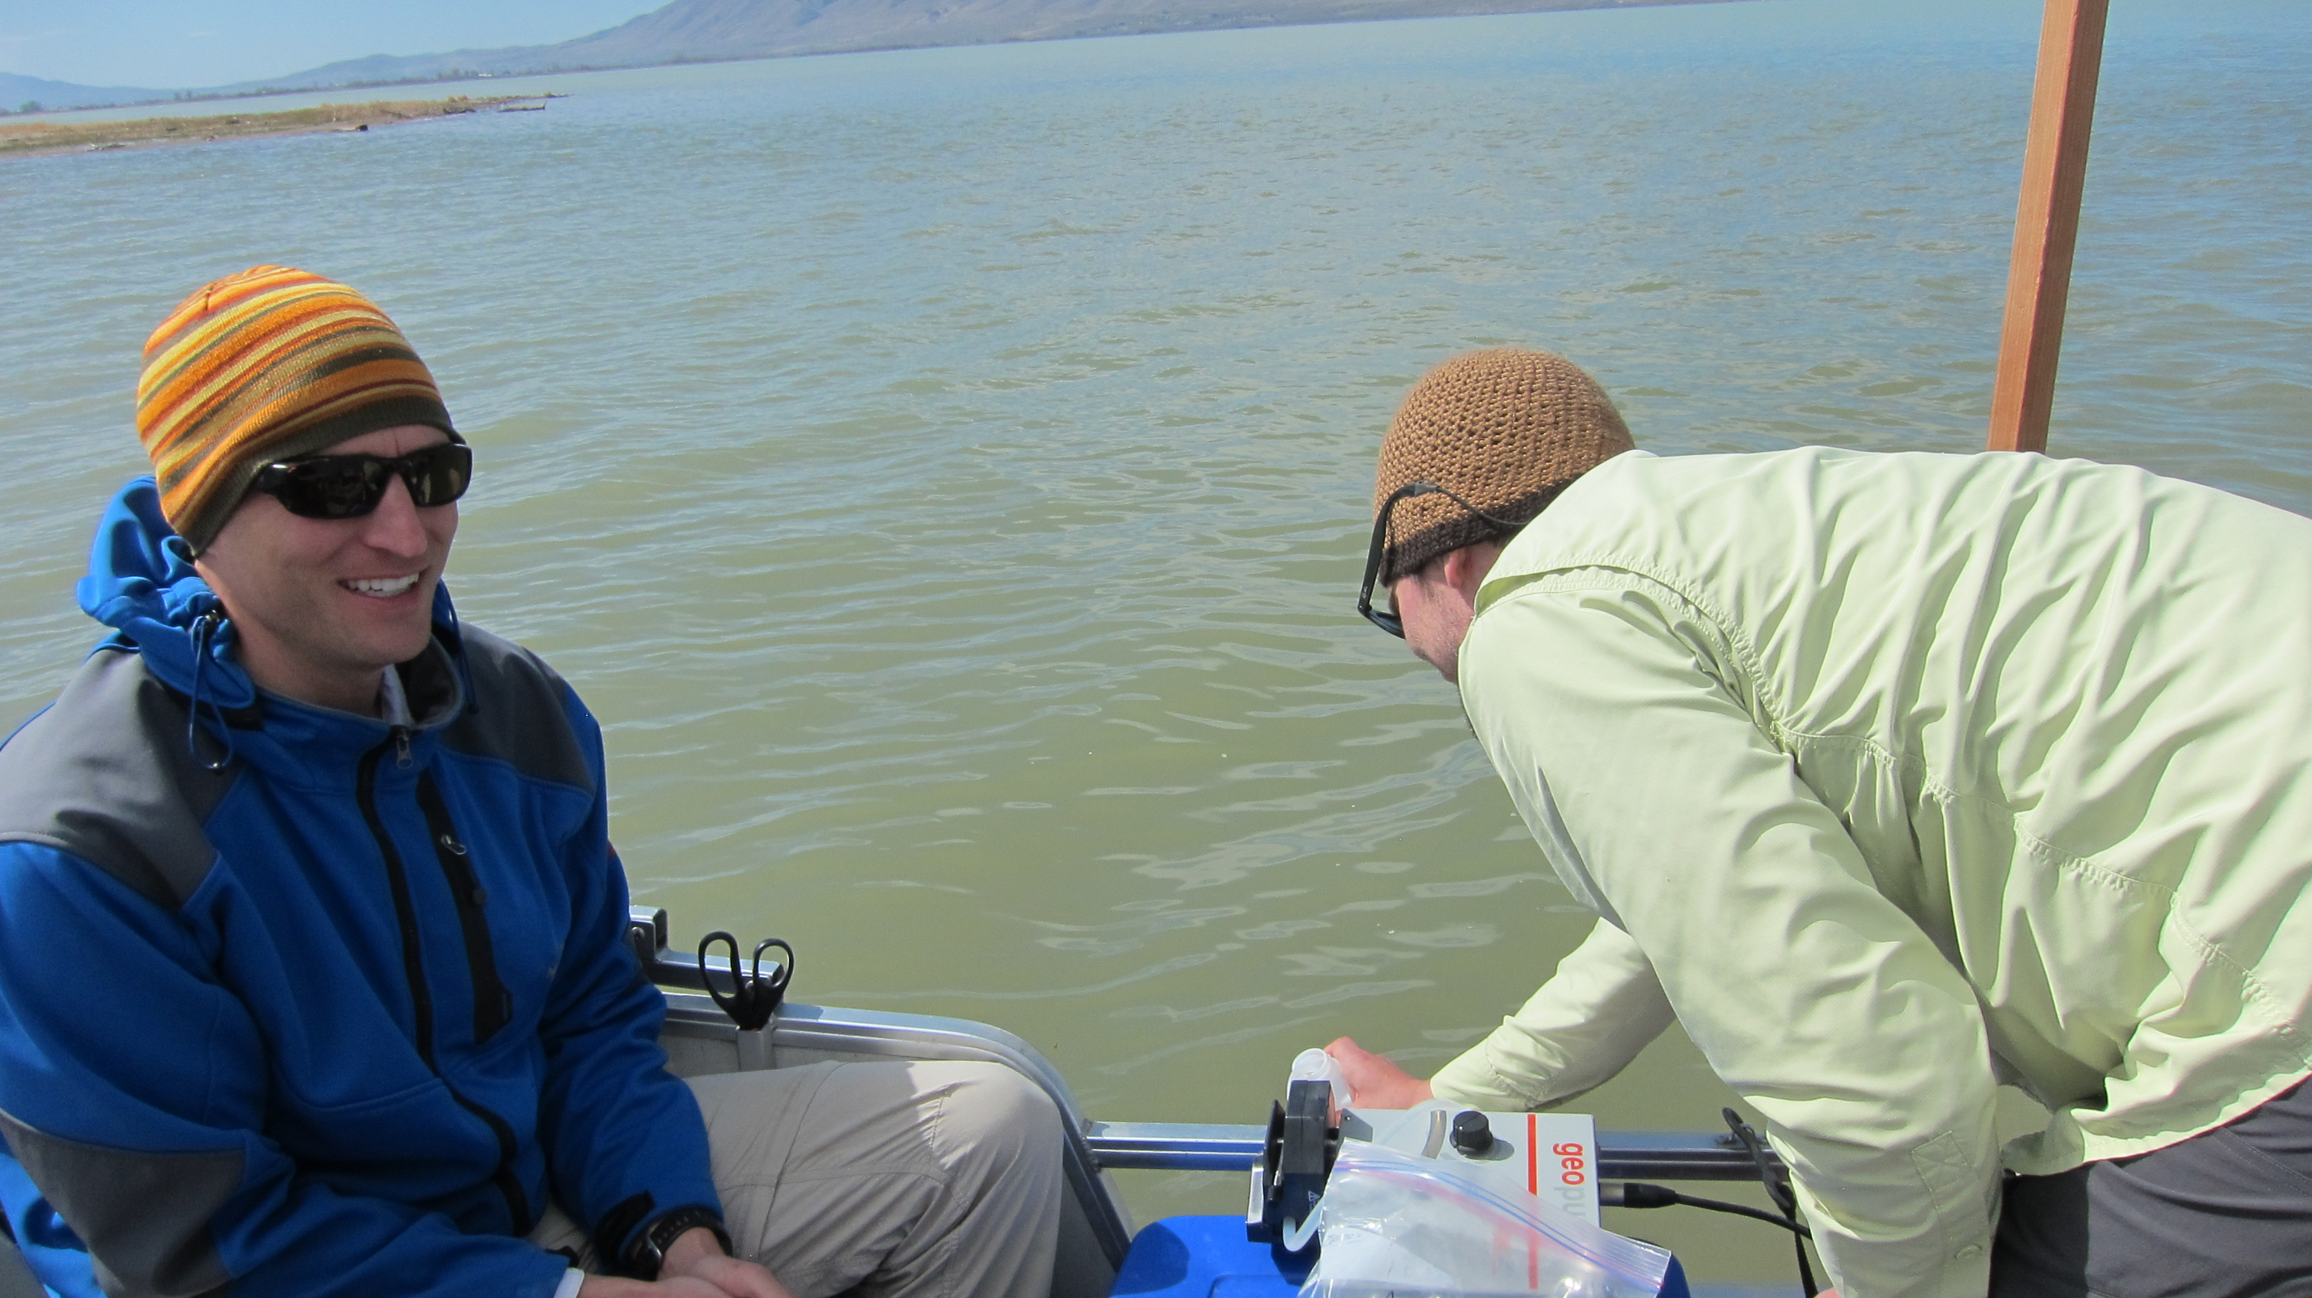
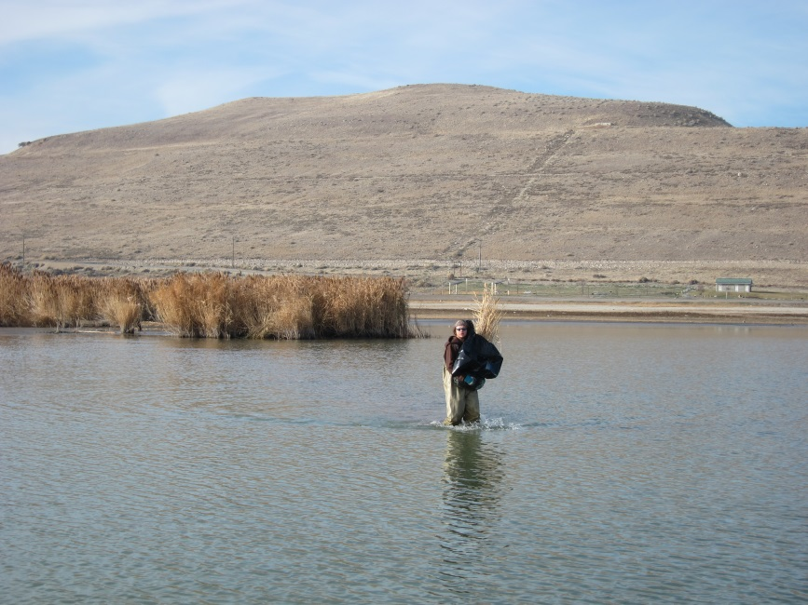

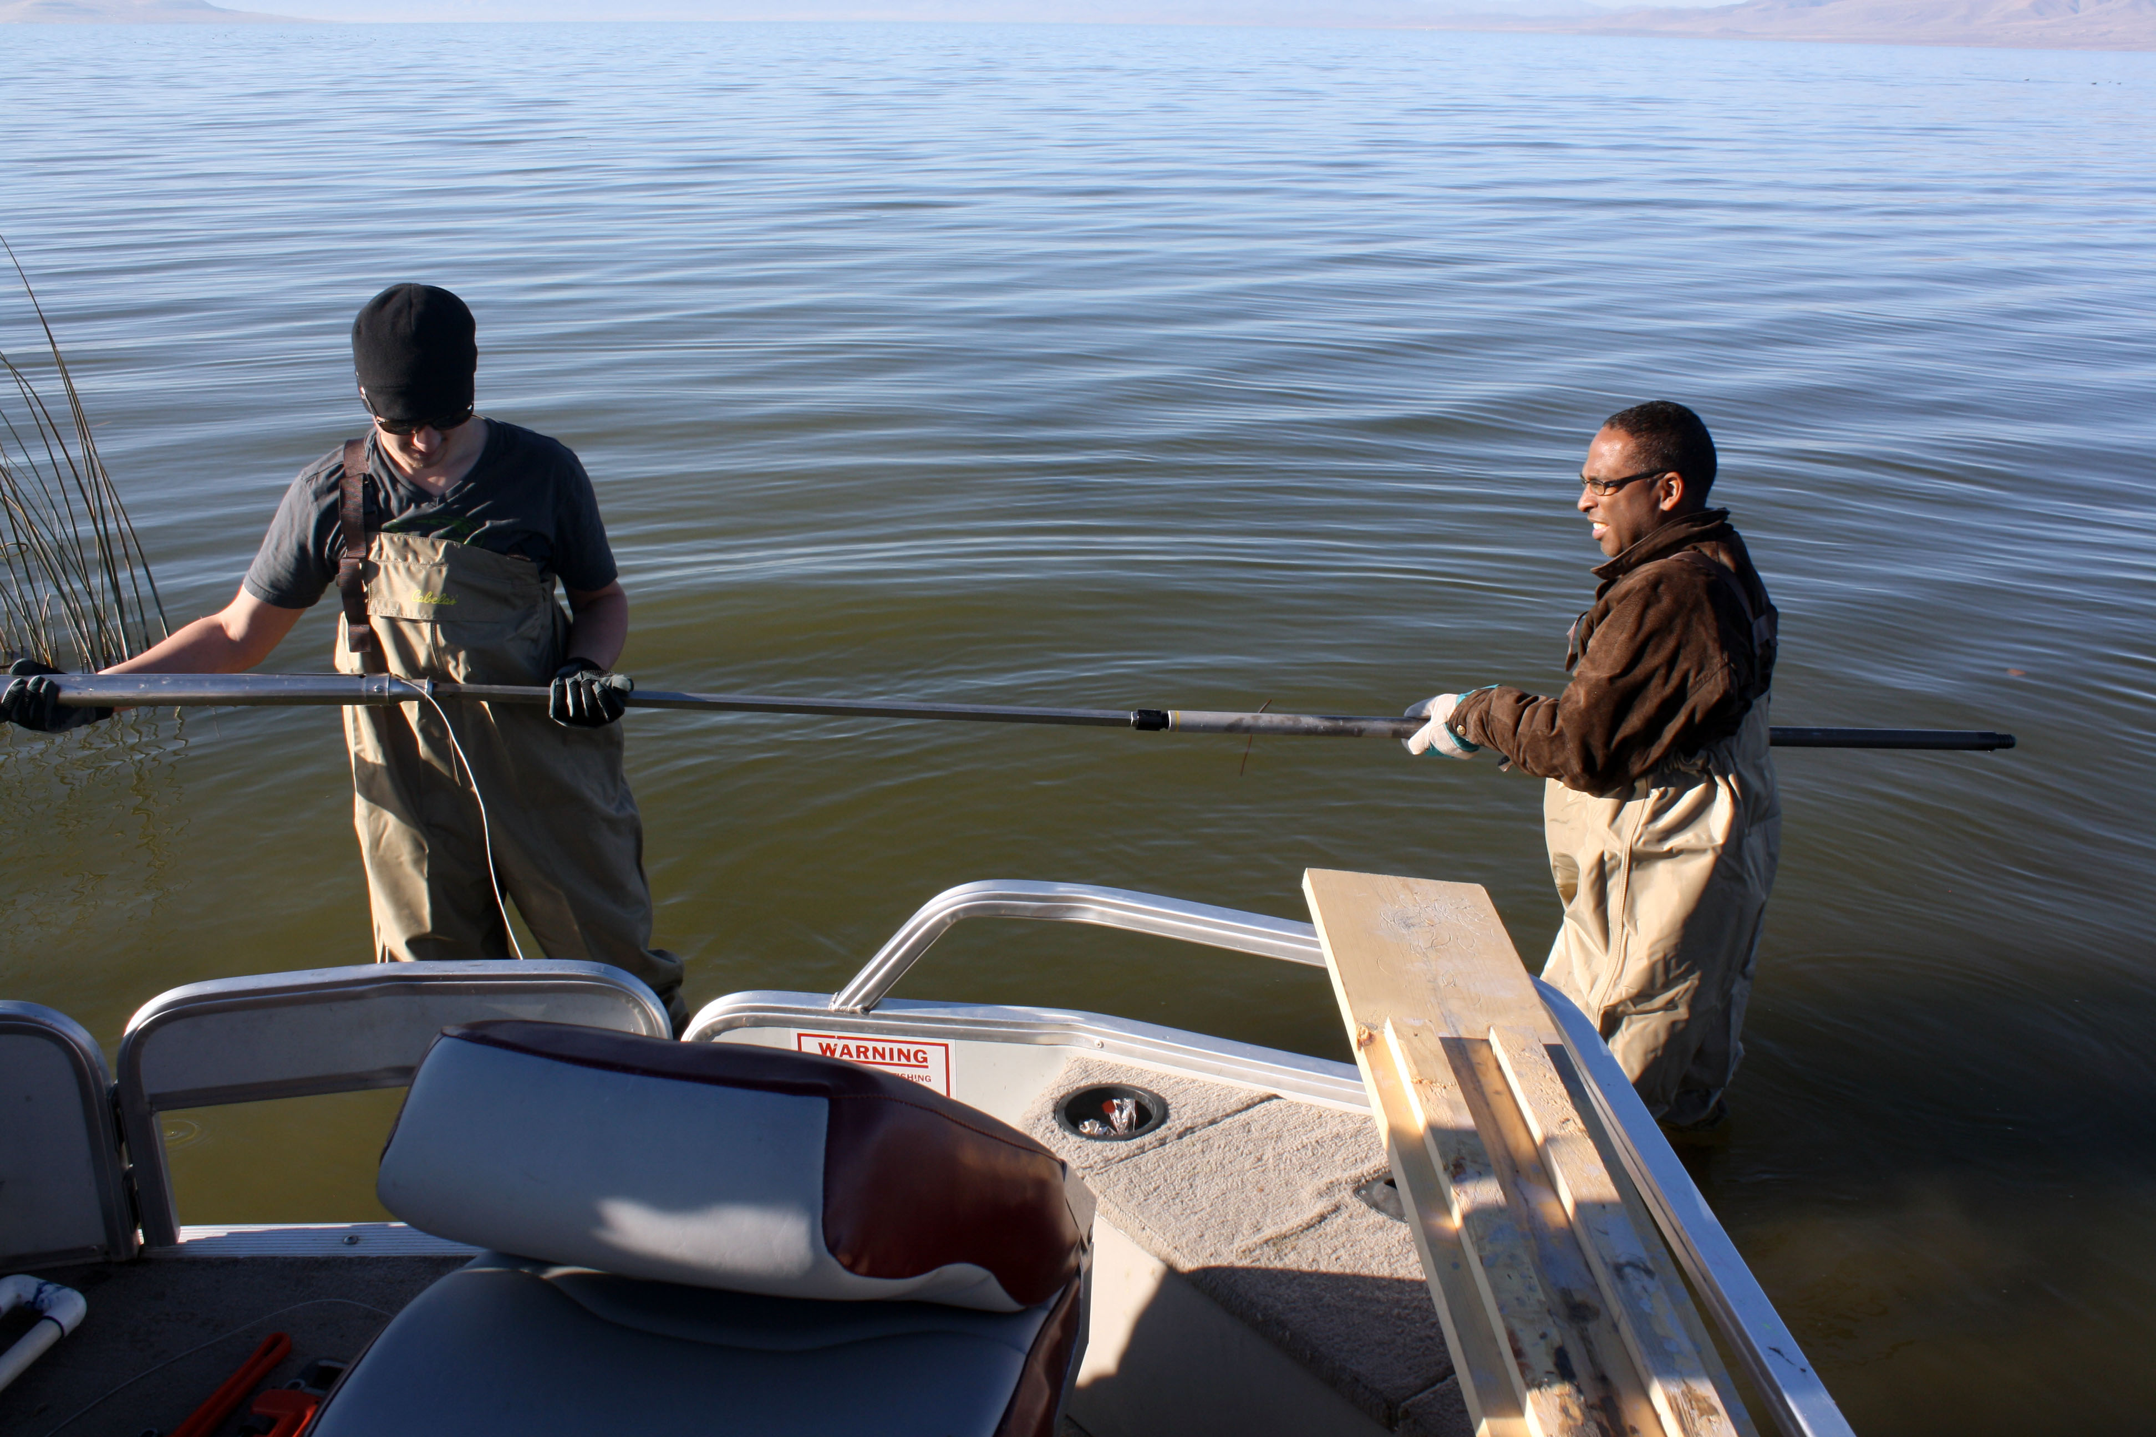
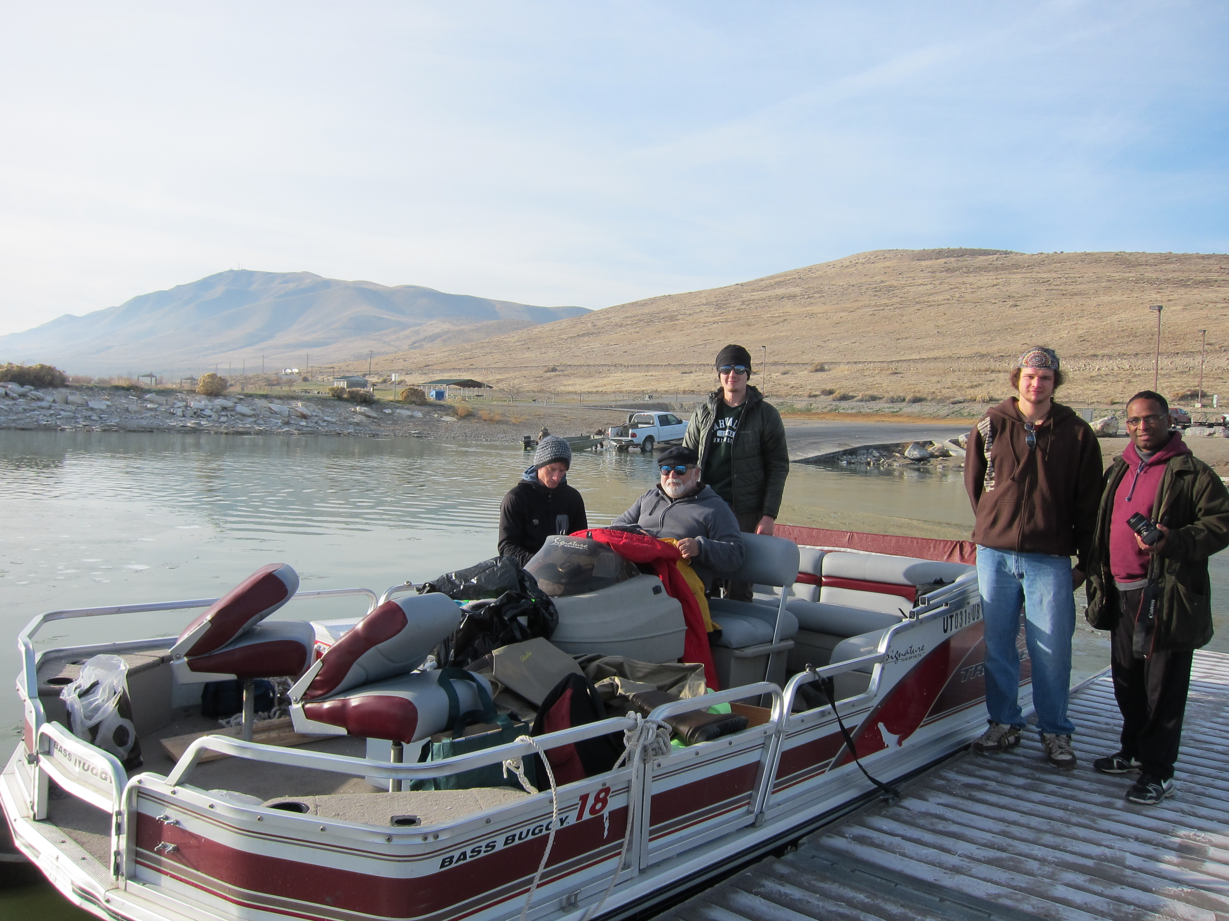
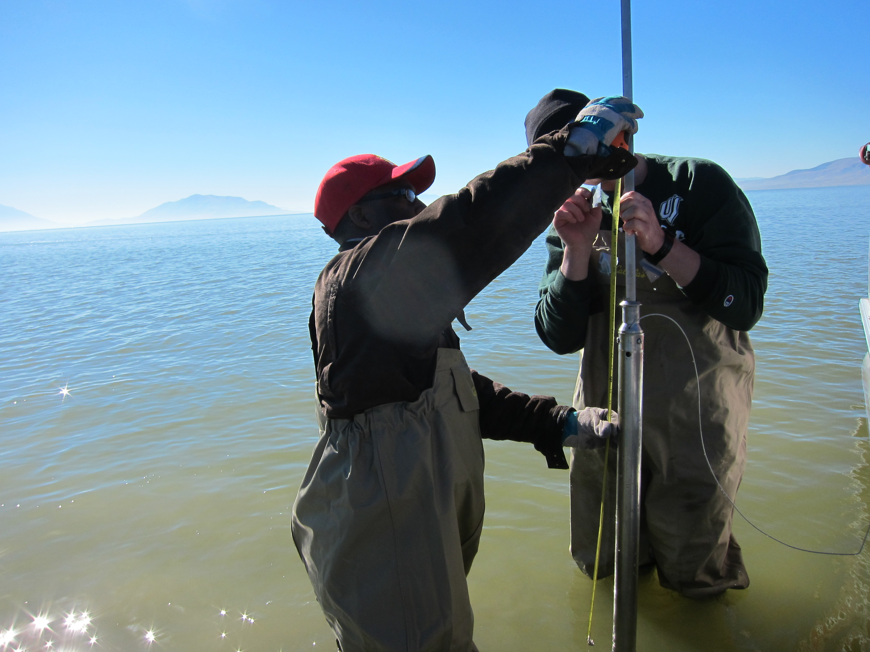
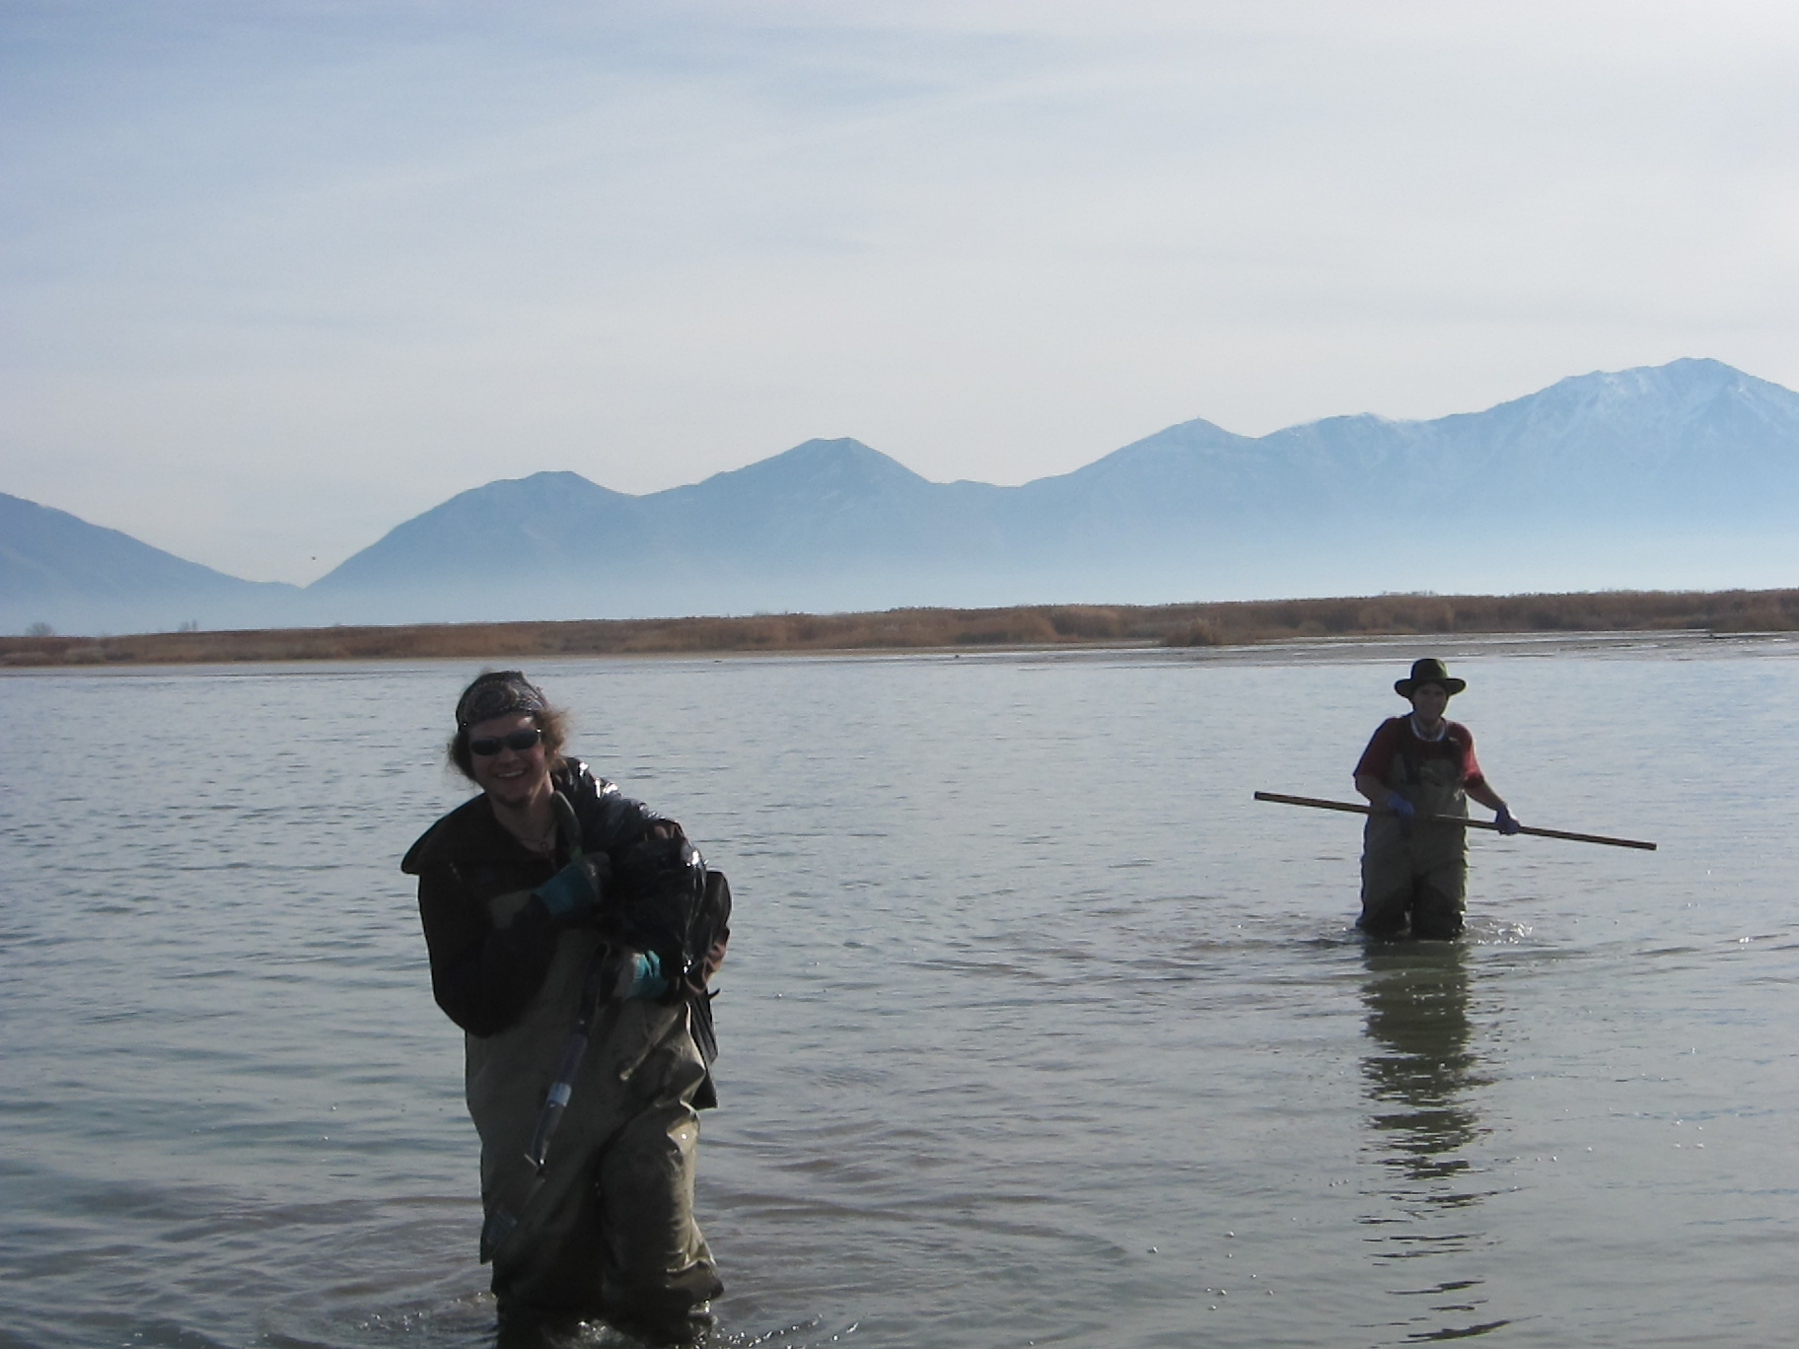
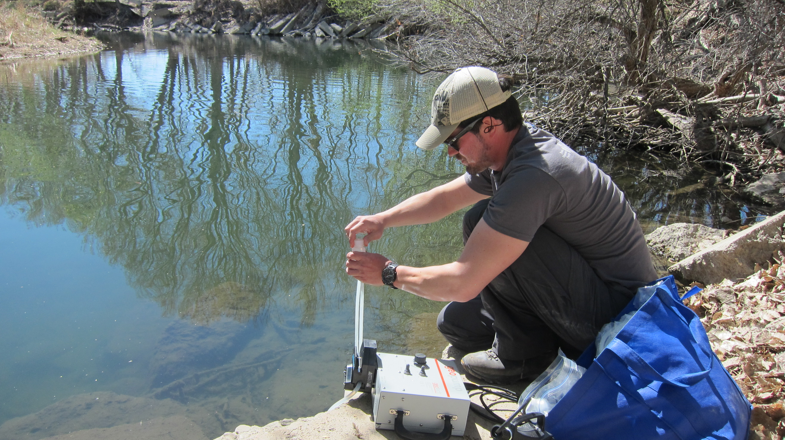
Field Work

Slide 8
Utah Lake Ecosystem
Anthropogenic
(δ¹³C = -12 to -26.5 ‰)
(C:N <10)
terrestrial
(δ¹³C = -26.5 ‰)
(C:N=15-35)
Phragmites
(δ¹³C =-27.2 ‰ )
(C:N=25-45)
Benthic algae
(δ¹³C =-15 to -20 ‰)
(C:N=4-10)
phytoplankton
(δ¹³C =-30 to -25 ‰)
(C:N=4-10)

Slide 9
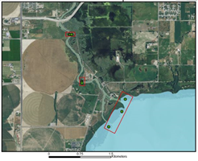
Depth profiles of δ¹³C and δ¹⁵N, C/N
Results
UL1c
UL1b
UL1a
1.5 km

Slide 10
Binary plots between C/N ratio and δ¹³C
Terrestrial C3 and aquatic C4 plant detritus
Terrestrial/human derived organic matter and C3 aquatic plant detritus
Terrestrial/human derived organic matter and C3 aquatic plant detritus
Freshwater
algae
Terrestrial/human derived organic matter and C3 aquatic plant detritus
UL1c
UL1b
UL1a
1.5 km

Slide 11
Arsenic
Results
UL1a
UL1b
UL1c
Background level:
Background concentration in land soil: 5.5 mg kg⁻¹
Curves suggest high historical discharge in this area.
The peninsula at UL1b may be preventing As from moving OR vegetation on peninsula taking in As.
UL1c
UL1b
UL1a
1.5 km
Notes:
-Floc layer (about 20 cm deep) important whatever metal concentrated in it is what can potentially be released into water due to turbidity.
As levels exceeded the background concentration in the North Lateral, and was highest in the floc layer.
- peninsula barrier
- more vegetation?
In East Lateral, As decreased with depth from .5 mg kg¯¹ at 15 cm (floc layer) to 5.0 mg kg¯¹ at 45 cm, suggesting higher historical discharge of As in this area.
-As concentration exceeds background concentration level North Lateral in Floc Layer; 7.08666 mg kg-1
-Why higher concentration in North Lateral: the peninsula may be preventing As from moving OR vegetation on peninsula taking in As.

Slide 12
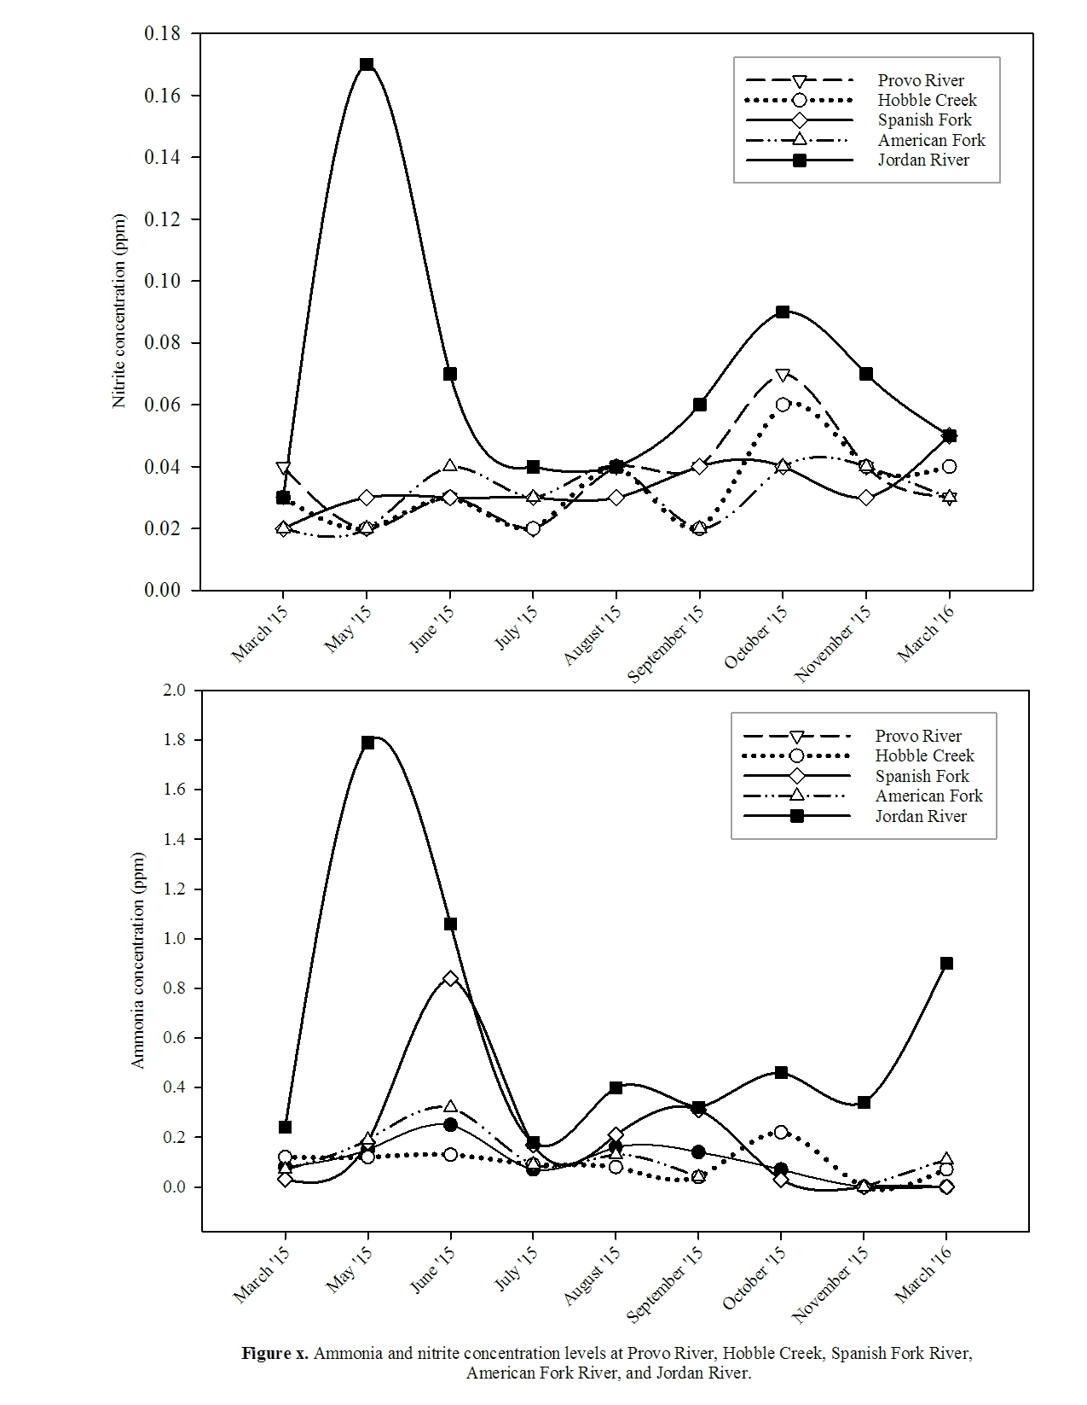

Slide 13
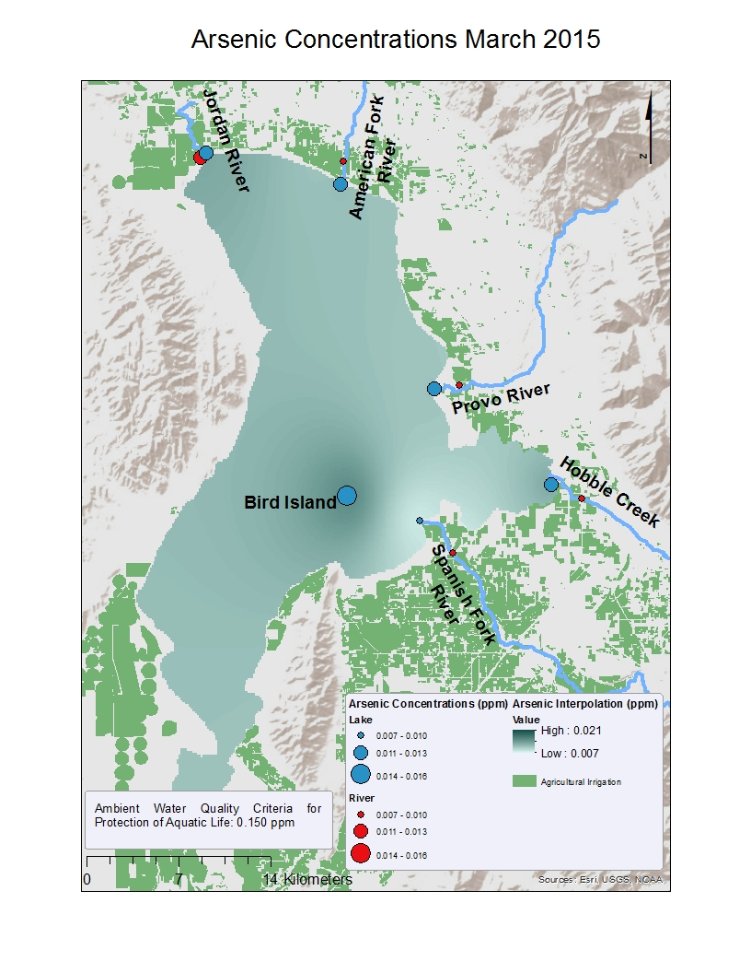
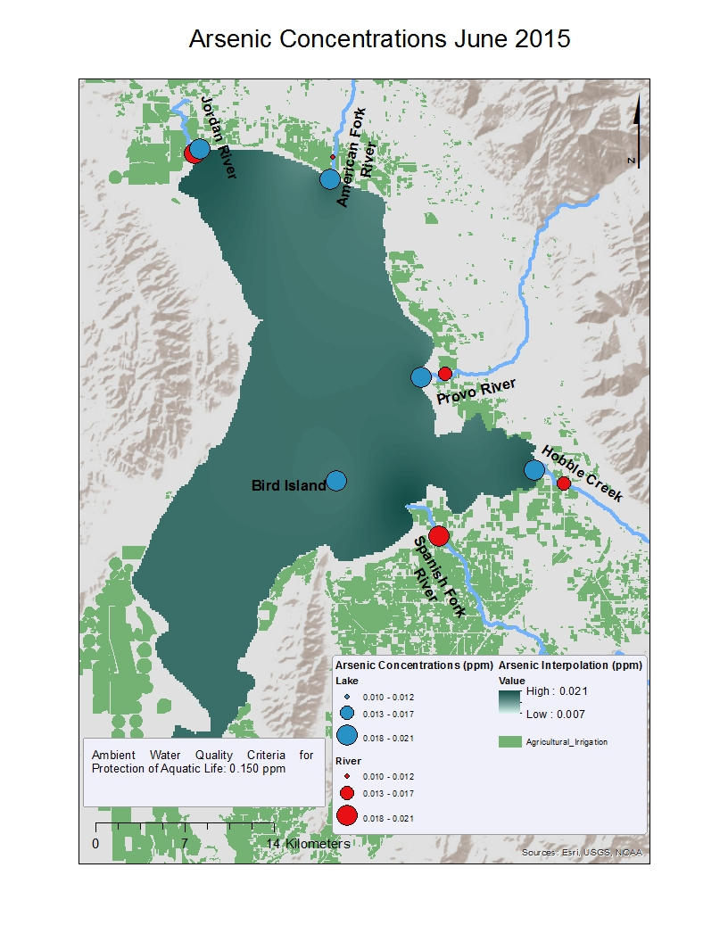
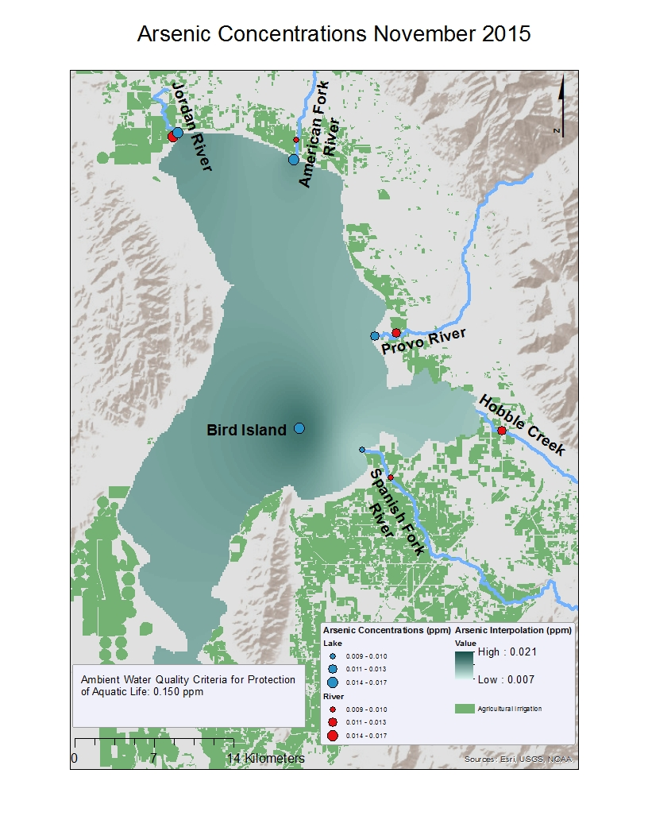
As Concentration

Slide 14
millions m³

Slide 15
Conclusions
C isotopic compositions in lake sediment cores were similar to terrestrial C3 and aquatic vascular plants. However, the C:N ratio in UL1c did indicate algae organic matter contribution to TOC.
N isotopic composition indicated effluent and manure input to the lake over time
As accumulated at higher concentrations in the floc layer of the UL1b. Accumulation may be due to the presence of the underwater peninsula formation which restricts the flow of these elements into the Jordan River.
In June, significantly elevated arsenic concentrations in the river water are potentially caused by non-point sources such as farming practice in surrounding areas.
Overall, the As concentrations at the lake locations tend to be higher than at the river locations. This indicates that the lake acts as a sink for this element.
Clear temporal and spatial concentration variations indicate that Utah Lake is not horizontally well mixed and non-point pollution sources are important contributors for the elevated trace metals in Utah Lake

Slide 16

Acknowledgments
Projects Funded by
Student researchers
Collaborators
SAC
GEL
iUTAH
Dr. Eddy Cadet
Dr. Alessandro Zanazzi
Dr. Suzanne Walther
Dr. Greg Carling
Dr. Steve Nelson
Kevin Rey
Joel Bradford
Russell Harrel
Hannah Peterson
Henintsoa Rakotoarisaona
Buchanan Kerswell
Paul Robertson
Joshua Jackson

Slide 21
Conclusions
UL1c
UL1b
UL1a
1.5 km

Slide 22
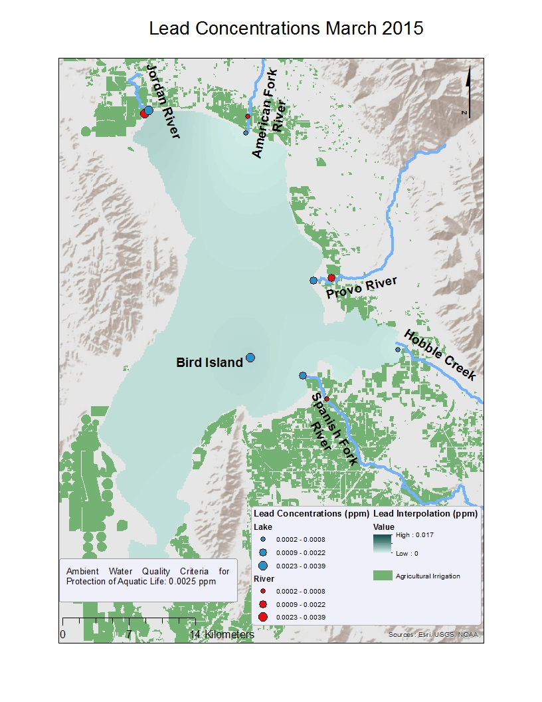
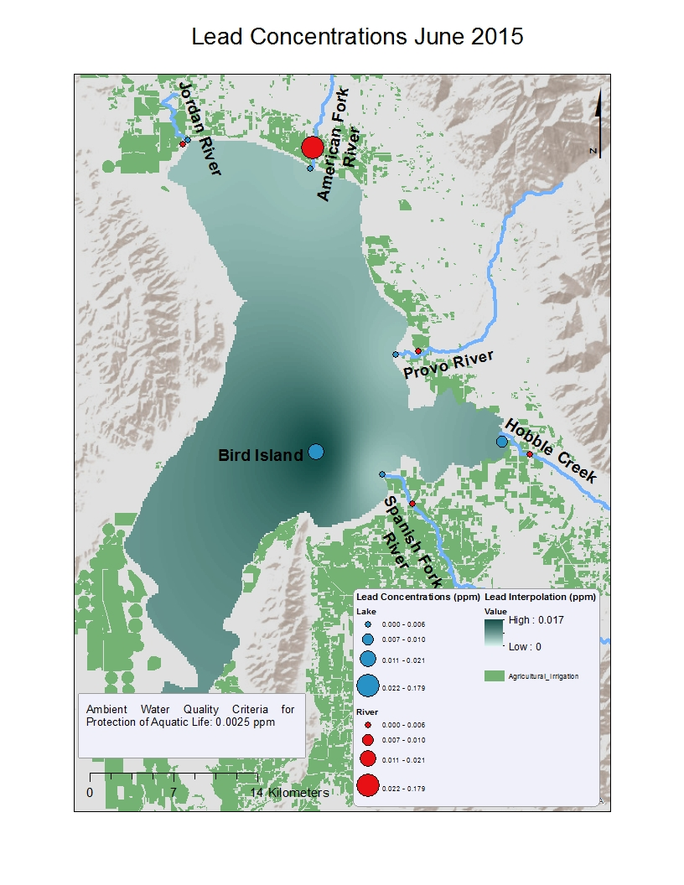
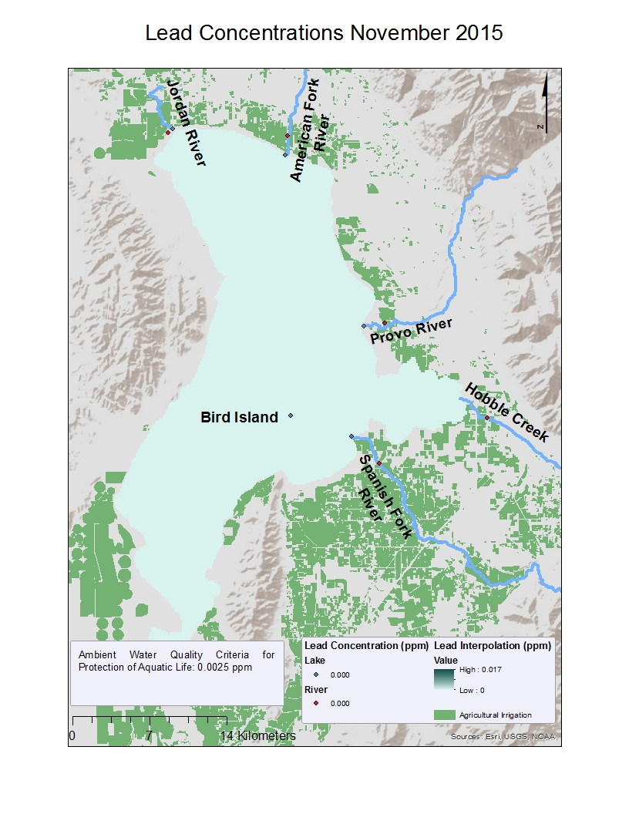
Pb Concentration

Slide 26
Spanish Fork
Spanish Fork
Hobble Creek
Hobble Creek
Provo River
Provo River
American Fork
American Fork
Jordan River
Jordan River

Slide 27
SF Lake
Jordan River Lake
SF River
SF River

Slide 30
Anthropogenic Impact on Utah Lake Ecosystem
Mining
Landfill
Raw Sewage
Wetland drainage
Agriculture practice
Industrial development
Growing population
Wastewater treatment plants
Introduction of invasive species

